Slide 1
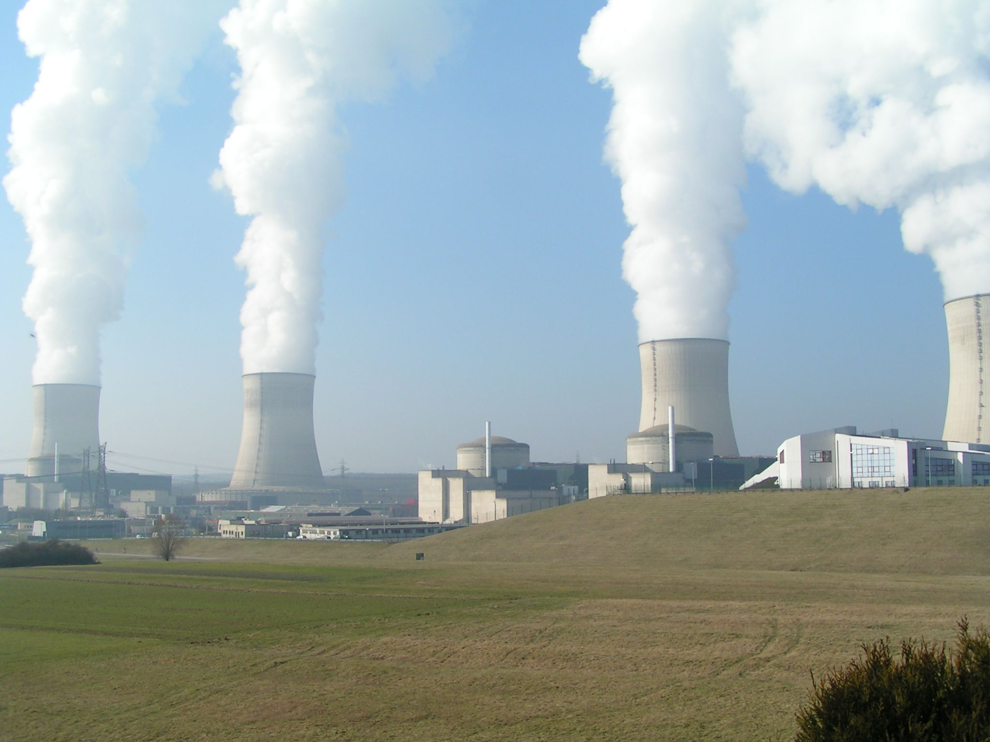
Fukushima Nuclear Safety: Myths and Realities

Slide 2
How does a Nuclear Power Plant work?

Slide 3
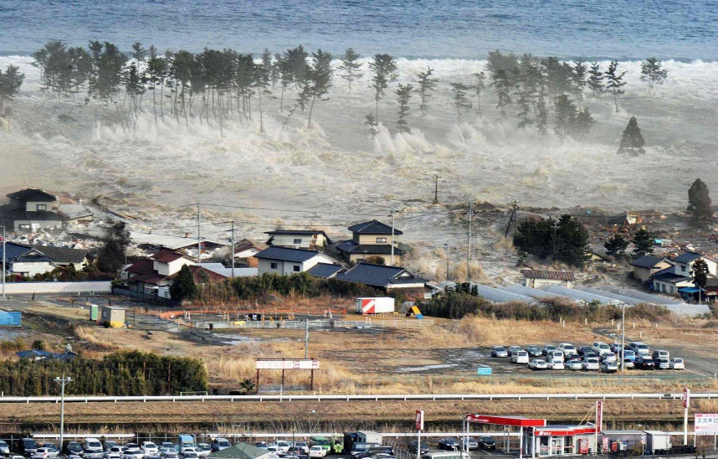
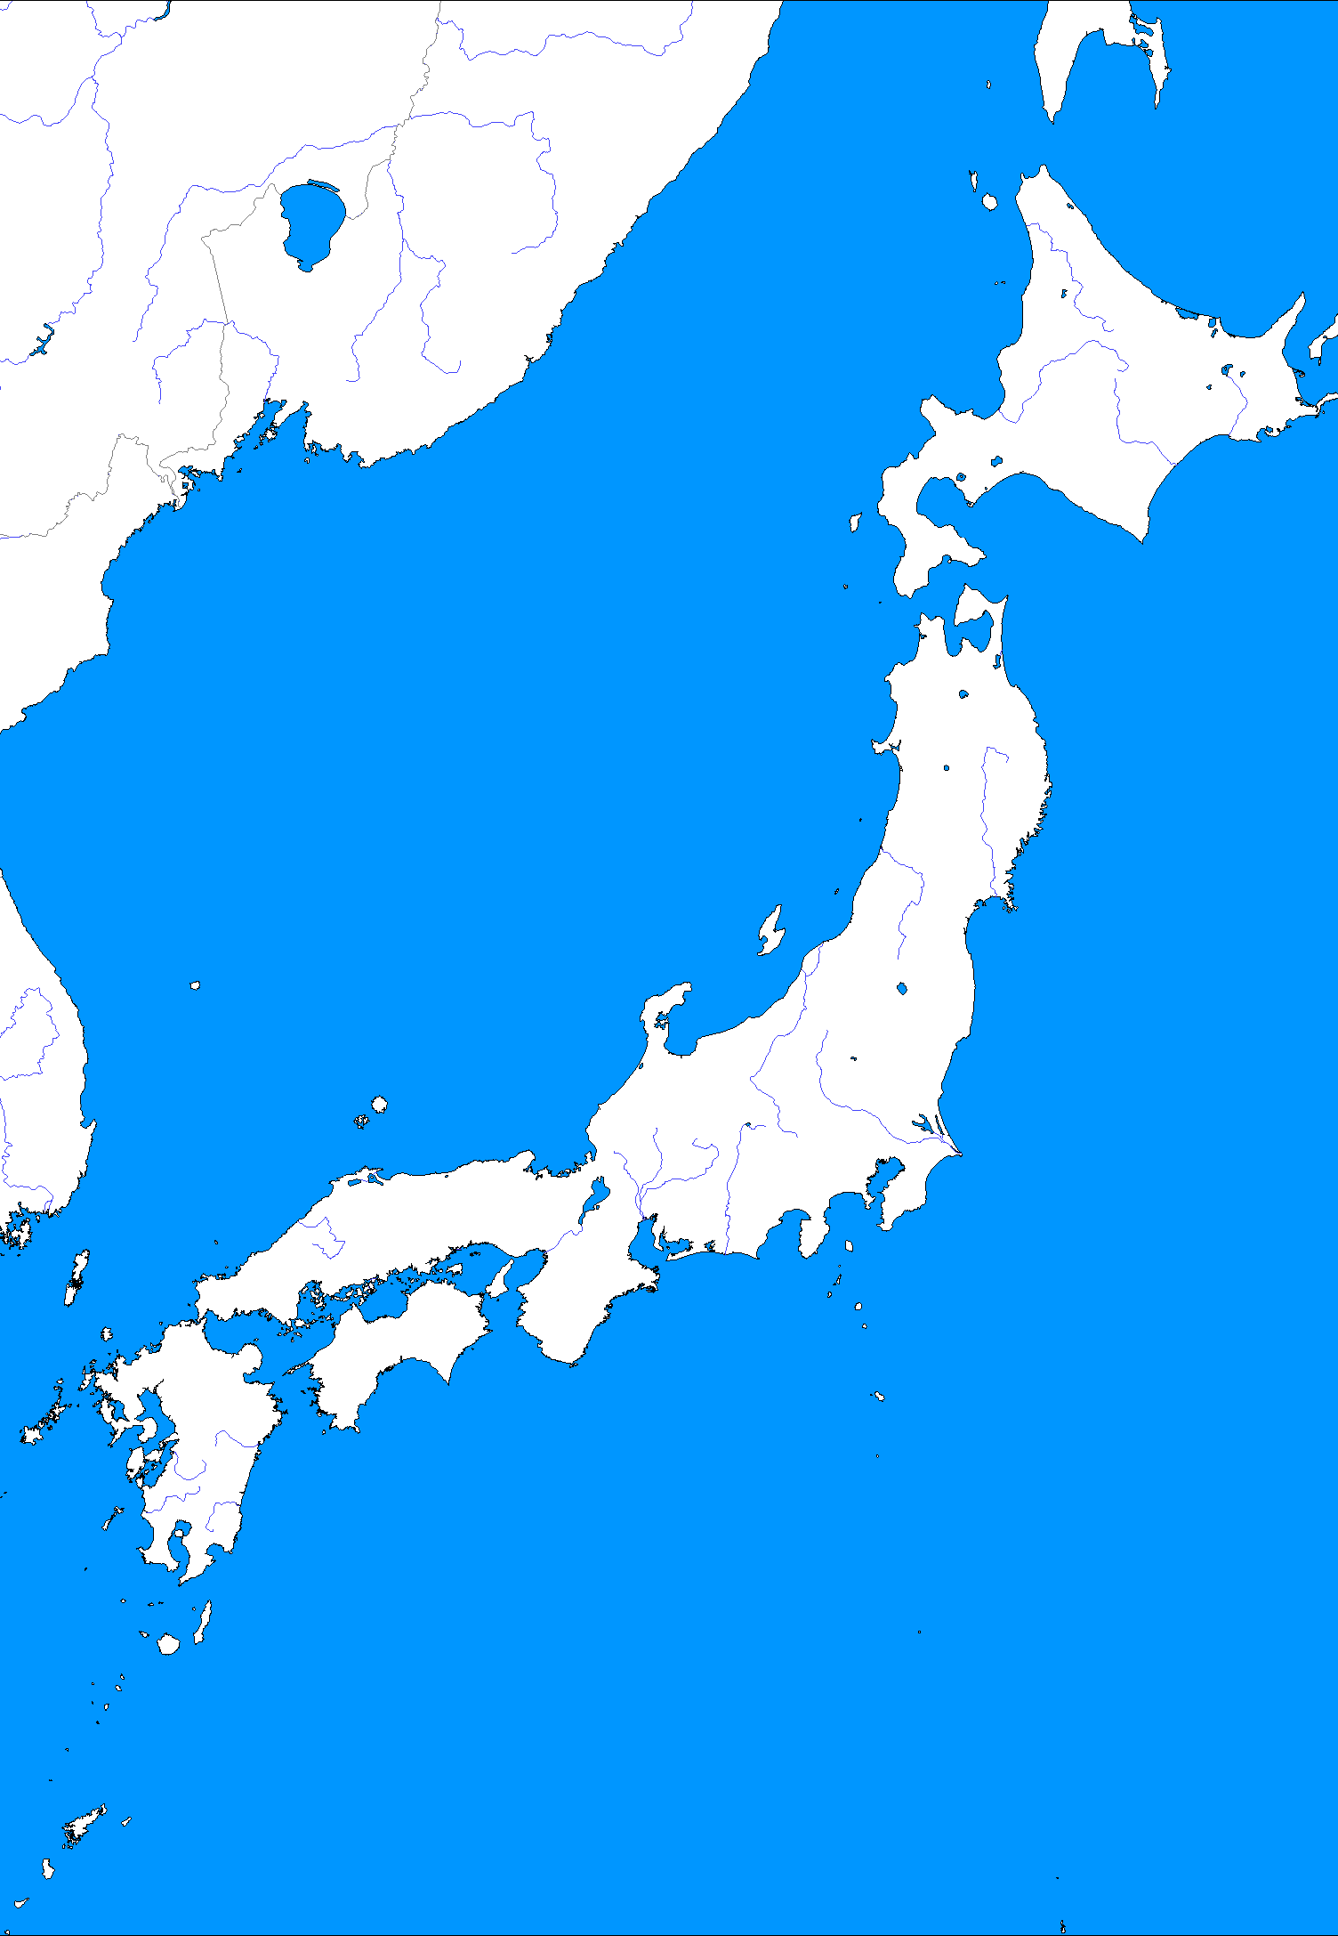
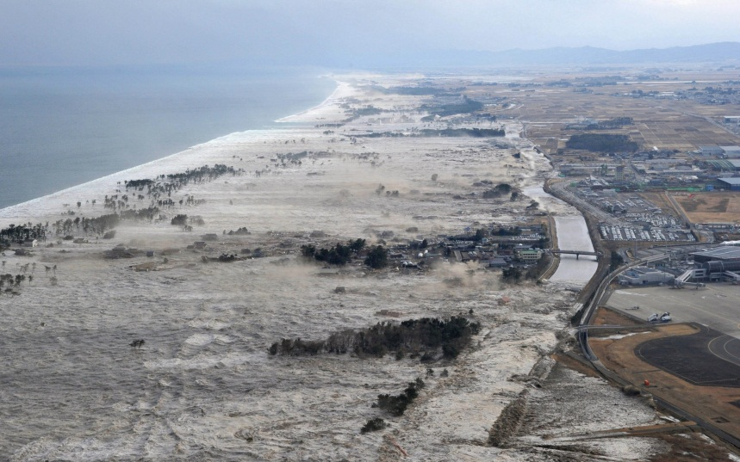
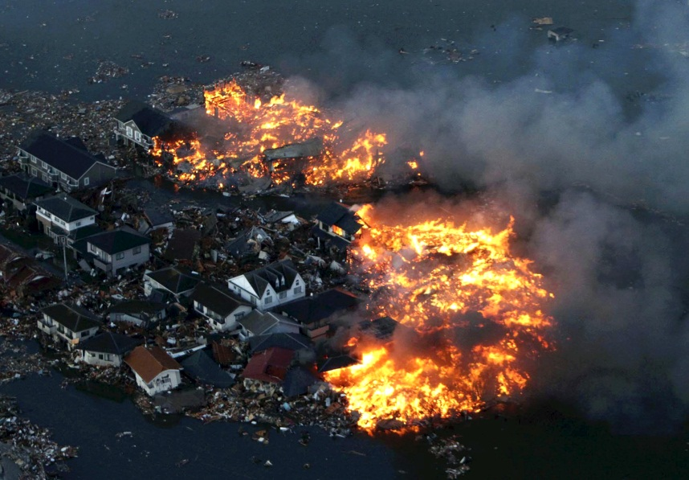
Earthquake & Tsunami
Fukushima 1

Slide 4
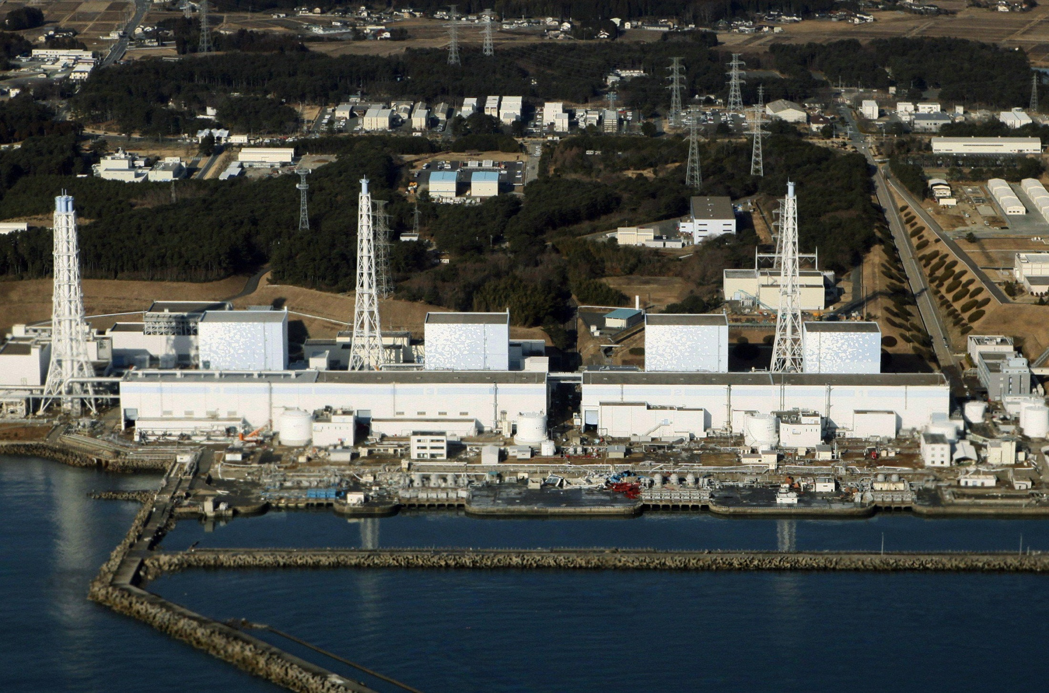
Fukushima
Nuclear reactors 1, 2 , 3 automatically stopped
Nuclear reactors 4, 5 , 6 were under maintenance
The fuel elements remained with their residual heat(<5%)

Slide 5
Fukushima
The emergency cooling systems operated in accordance with protocols
Failing main power supply due to earthquake, secondary systems worked normally powered by emergency diesel generators & batteries.
Between the earthquake and the impact of the tsunami, the safety protocols worked as intended by design.

Slide 6
Fukushima
Due to the tsunami, water flooded and left inoperative diesel generators, batteries and control systems of the nuclear power plant.
All actions were aimed to prevent overheating of the fuel elements in their pressure vessels and secondary pools.

Slide 7
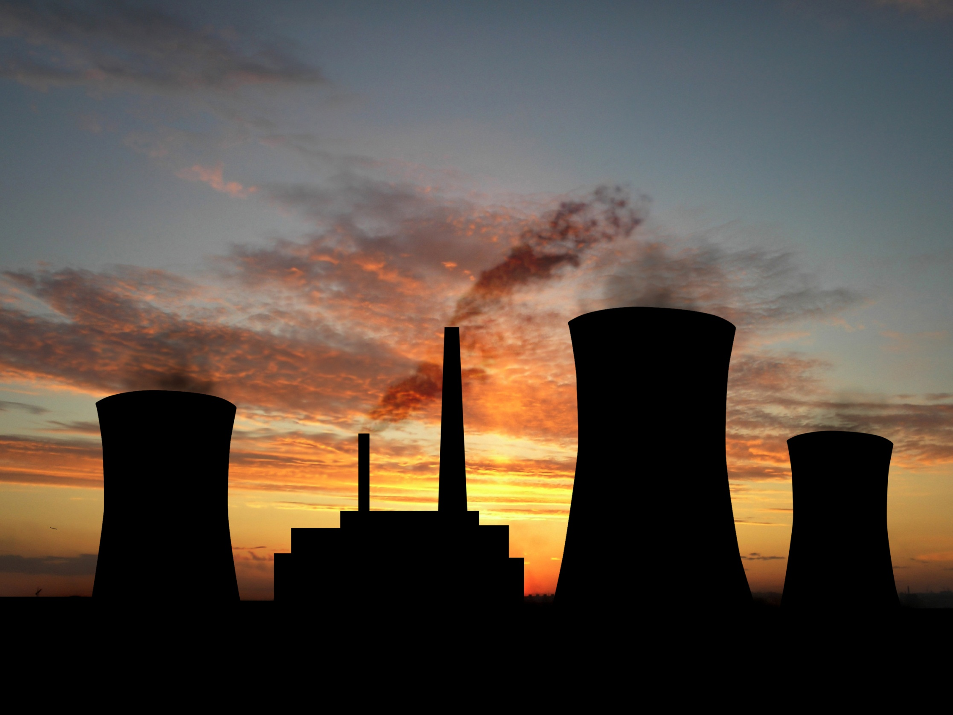
Future…

Slide 8
References
World Nuclear Power Reactors & Uranium Requirements". World Nuclear Association.
Nuclear Power Plant Information, International Atomic Energy Agency.
Key world energy statistics 2009
EIA Annual Energy Review 2007. U.S. Dept. of Energy, Energy Information Administration.
Country Analysis Briefs - Japan, US Energy Information Administration, published January 2004

