Slide 1
HYDRAULIC FRACTURING OPERATIONS: SEPARATING FACT FROM FICTION
Global Energy Security Forum
Miami, Florida
March 26, 2013
Mark K. Boling
President

Slide 2
Hydraulic Fracturing Operations
What are
Hydraulic
Fracturing
Operations?

Slide 3
Hydraulic Fracturing Operations
Hydraulic Fracturing Video

Slide 4
Regulatory Considerations
Surface Considerations
Subsurface Considerations

Slide 5
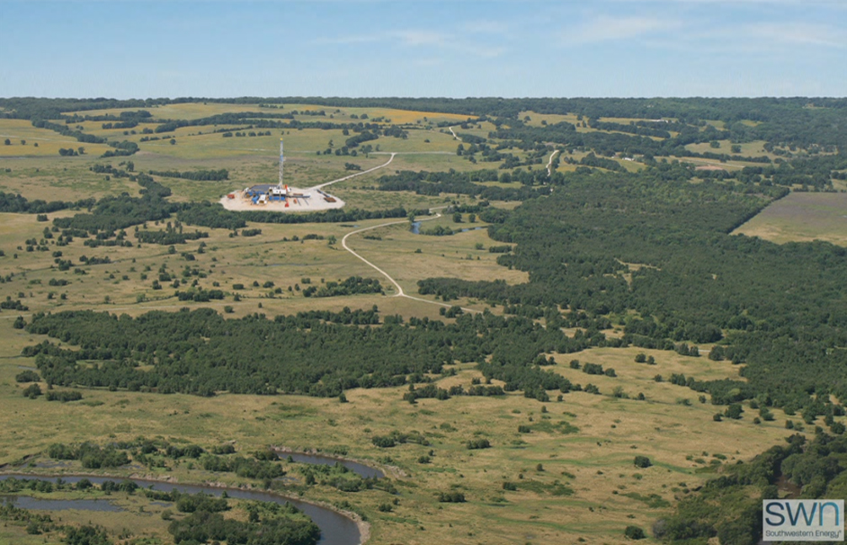
Surface Considerations
Air Emissions
Surface Impact
Drilling Locations
Truck Traffic & Road Damage
Infrastructure
Water Supply
Water Handling
Water Reuse & Disposal

Slide 6
Subsurface Considerations
Protecting Underground Water Resources
Frac Fluid Disclosure

Slide 7
Protecting Underground Water Resources
Well Integrity
Is the Key!

Slide 8
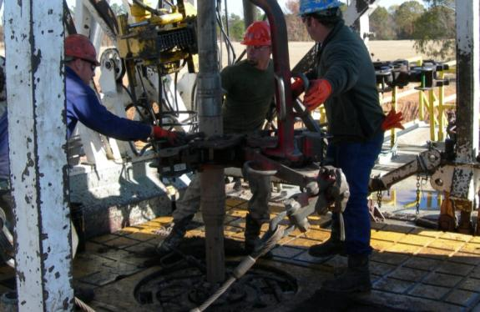
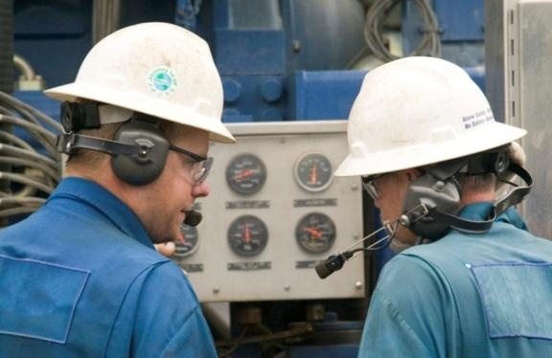
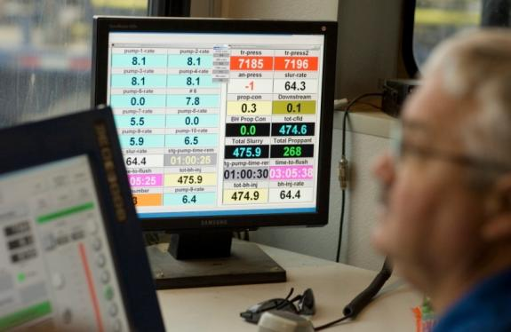
Well Integrity
1
Evaluate Stratigraphic Confinement
2
Well Construction Standards
3
Evaluate Mechanical Integrity of Well
4
Monitor Frac Job & Producing Well

Slide 9
GOOD MECHANICAL INTEGRITY
CONDUCTOR PIPE
FRESH WATER AQUIFER ZONE
SURFACE CASING
PRODUCTION CASING
SHALLOW PRODUCING ZONE
TARGET PRODUCING ZONE

Slide 10
CEMENT CHANNELING
CONDUCTOR PIPE
PRESSURE
BUILDS UP
FRESH WATER AQUIFER ZONE
SURFACE CASING
PRODUCTION CASING
FORMATION
SHALLOW PRODUCING ZONE
CASING
CEMENT
TARGET PRODUCING ZONE

Slide 11
Surface Considerations
Water Supply
Water Handling
Water Reuse & Disposal

Slide 12
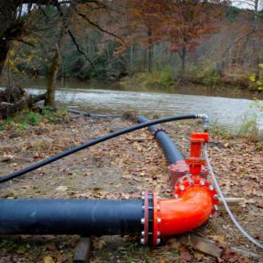
Water Supply
Volumes Needed
Location, Rate & Timing of Withdrawals
Cumulative Impact Assessment
11

Slide 13
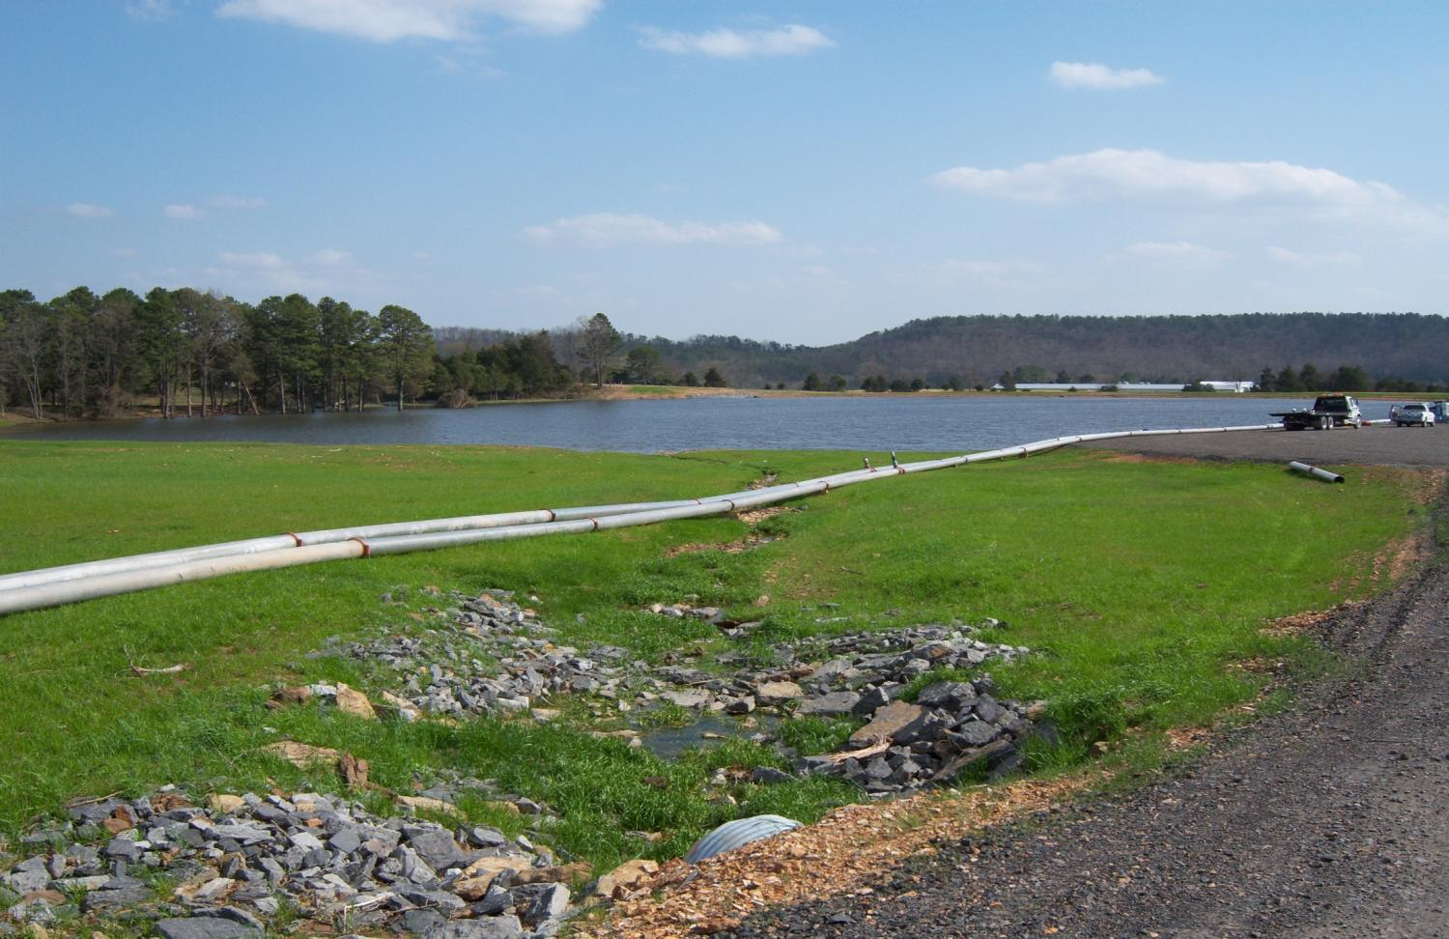
Water Handling
Trucks vs. Pipeline
Truck Traffic
Road Damage
Impoundments vs. Tanks
Closed-Loop Drilling Systems
Recycling Logistics
Air Emissions
Tracking Wastewater
Characterize Wastewater
Record Volumes Produced
Verify Volumes Delivered

Slide 14
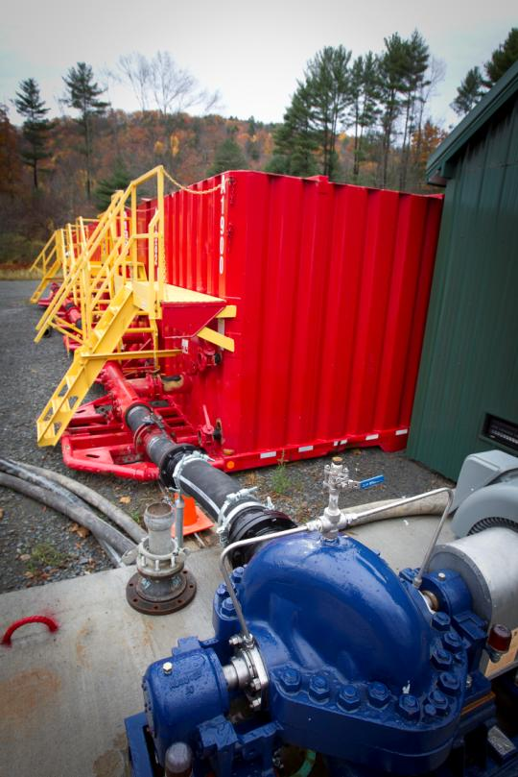
Water Reuse & Disposal
Water Recycling & Reuse
Volume and quality of wastewater
Chemical compatibility
Storage and transportation logistics
Water Treatment Facilities
Flowback & produced water chemistry
Capacity & Capability limitations (NORM, DBPs, heavy metals)
Central vs. drill site facilities
Water Disposal Wells
Geological & hydrological limitations
NIMBY concerns
Triggered seismicity considerations

Slide 15
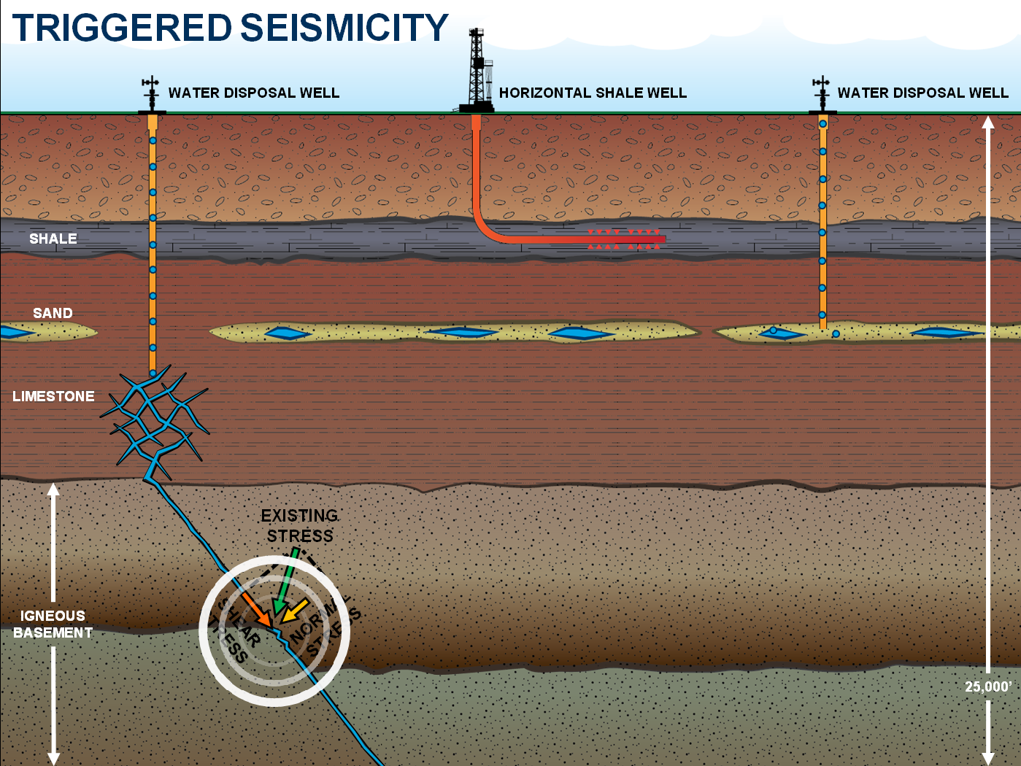
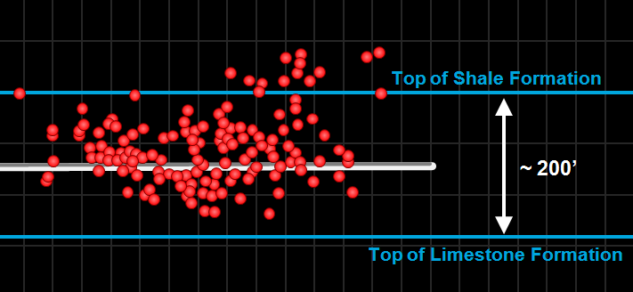
TRIGGERED SEISMICITY
WATER DISPOSAL WELL
HORIZONTAL SHALE WELL
WATER DISPOSAL WELL
SHALE
SAND
LIMESTONE
EXISTING
STRESS
NEW
STRESS
IGNEOUS
BASEMENT
SHEAR
STRESS
NORMAL
STRESS
The largest recorded seismic event generates the same amount of energy as would be released when dropping a gallon of milk from chest high to the floor.
25,000’

Slide 16
Surface Considerations
Air Emissions
Emission Type
NO_{x}
SO₂
CO
PM
CH₄
VOCs (incl. BTEX)
Reduction Technology
Catalytic reduction
Ultra-low sulfur diesel fuel
LNG and CNG fuels
Oxidation catalysts
Green completions, vapor recovery units, low bleed/no bleed pneumatic devices, plunger lift systems, leak detection
Emission Levels
EPA
Industry
State regulators
Research groups

Slide 17
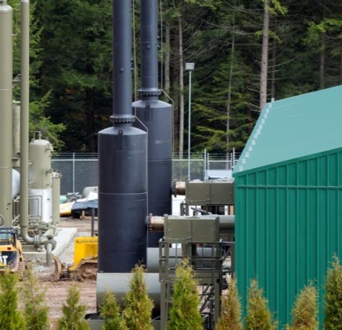
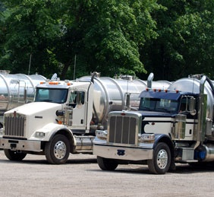
Surface Considerations
Surface Impact
Drilling Locations
Pit construction
Erosion and sedimentation
Chemical storage
Infrastructure
Compressors
Pipelines
Roads
Water treatment facilities
Truck Traffic & Road Damage

Slide 18
HYDRAULIC FRACTURING OPERATIONS: SEPARATING FACT FROM FICTION
Global Energy Security Forum
Miami, Florida
March 26, 2013
Mark K. Boling
President

